Slide 1
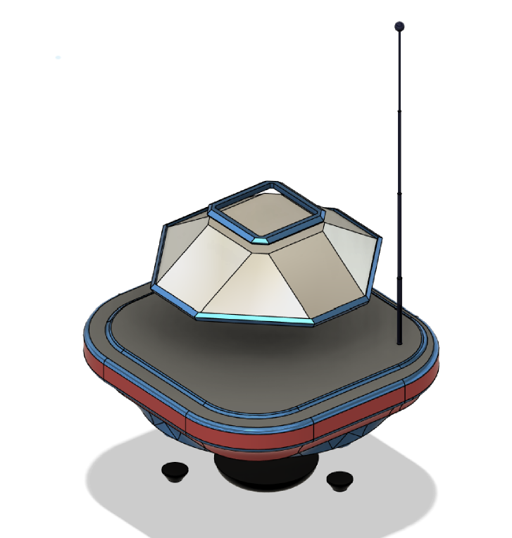
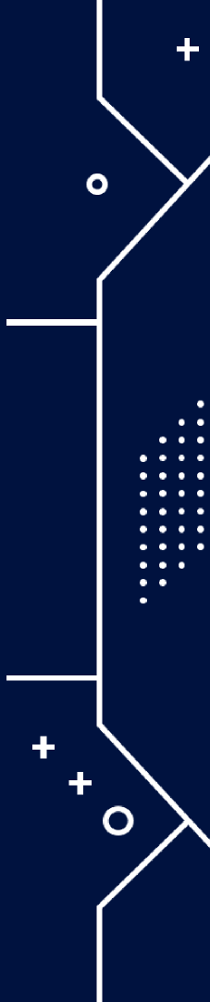
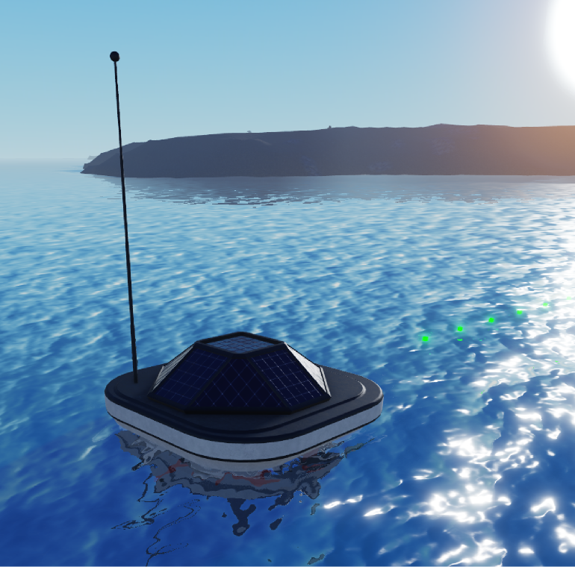


NEPTUNE-R​
(Nautical Environmental Purification and Turbulence Unit for Natural Enrichment – Robot)​ Solar-Powered Autonomous Oxygenizer HydroRover

Slide 2
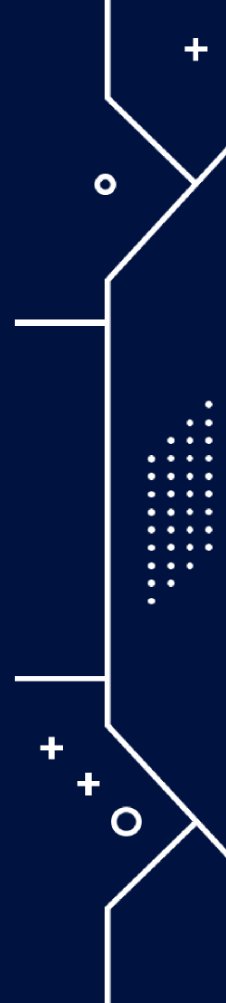

Motivation
Issue:
Lack of oxygen (hypoxia) severely disrupts ecological balance and endangers aquatic life.
Solution:
An autonomous rover providing continuous water oxygenation sustainably using solar power.
Benefits:
Reduced environmental impact;
Energy-efficient;
Autonomous operations.

Slide 3


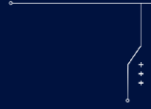


MATLAB Simulation Overview
Purpose:
Initial modeling and testing of the rover's trajectory and oxygenation efficiency.
Methods:
  Euler’s method for Physical laws.
  Simulation of rover trajectory on water surface using Archimedean spiral and Boustrophedon coverage.
  Shore and island/object avoidance incorporated into simulation.
Visuals:
Screenshot of MATLAB plots illustrating trajectory paths and oxygenation points.

Slide 4

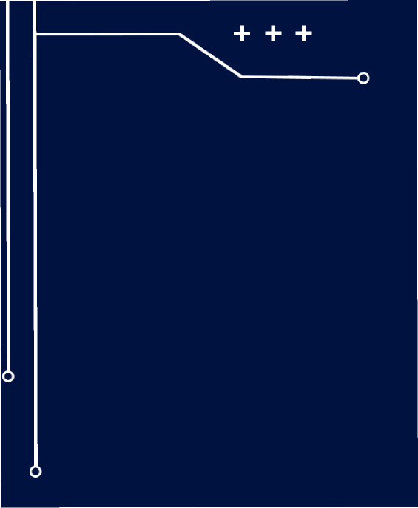
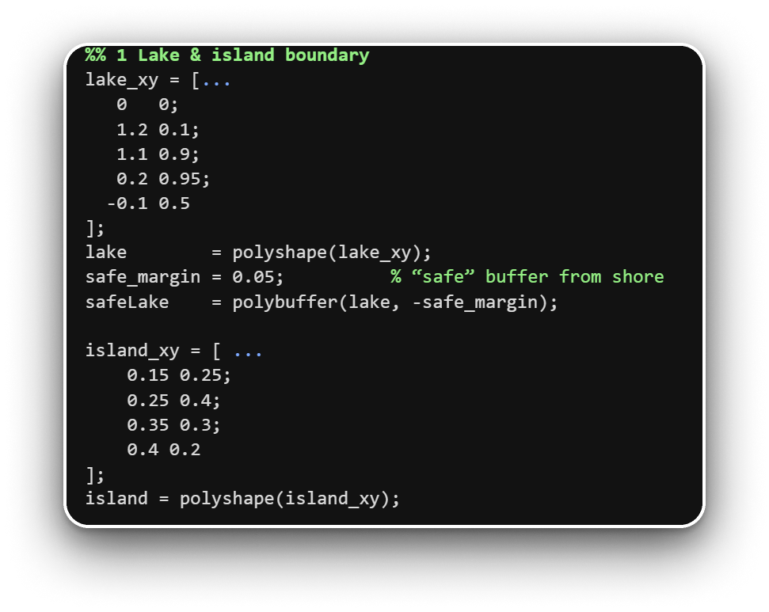
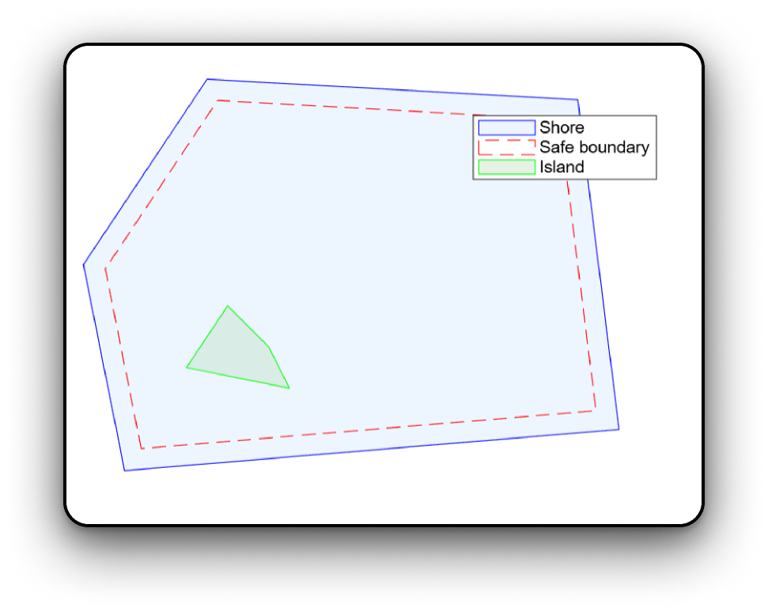

Lake & island projection

Slide 5



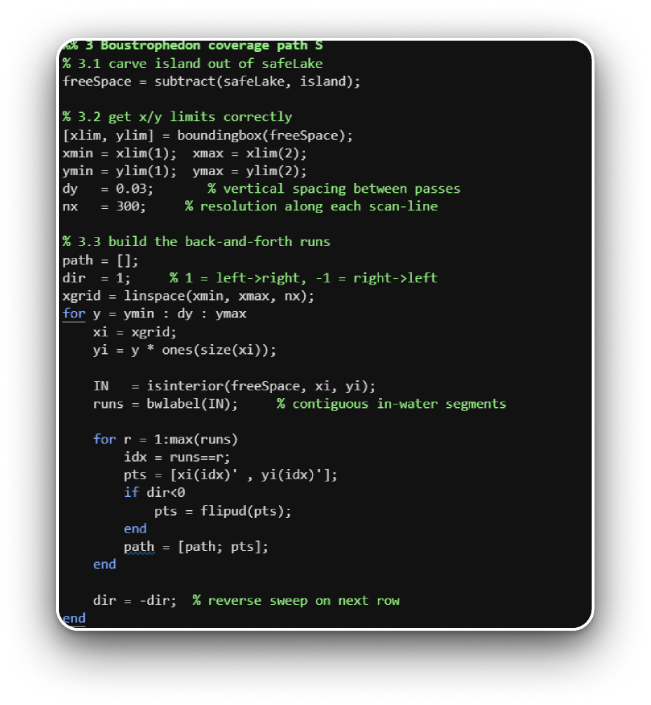
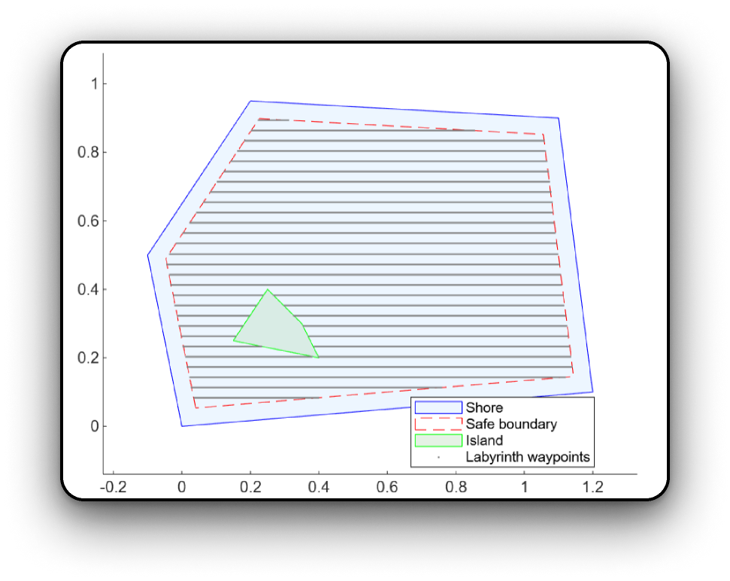
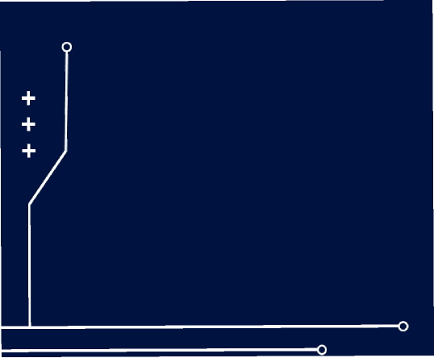

Path finder

Slide 6
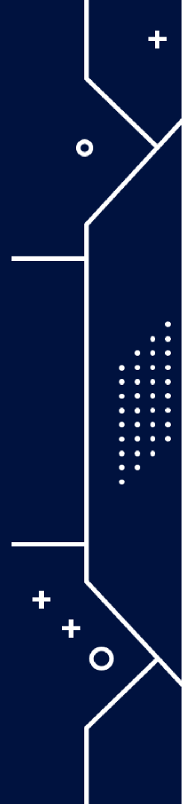

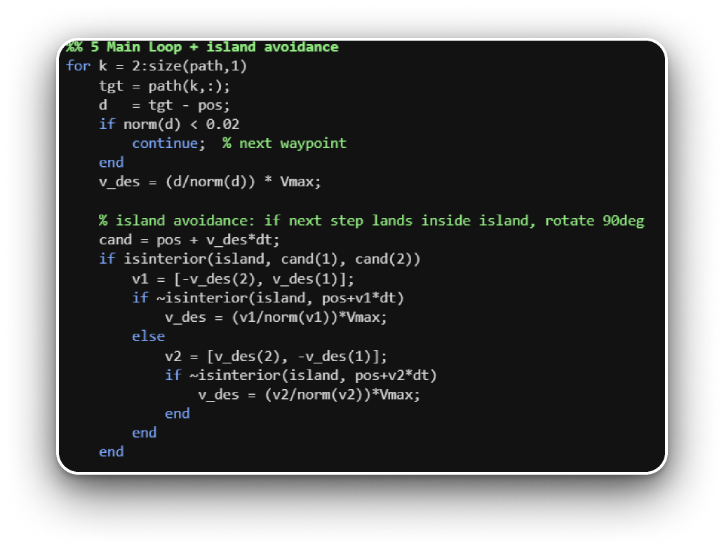
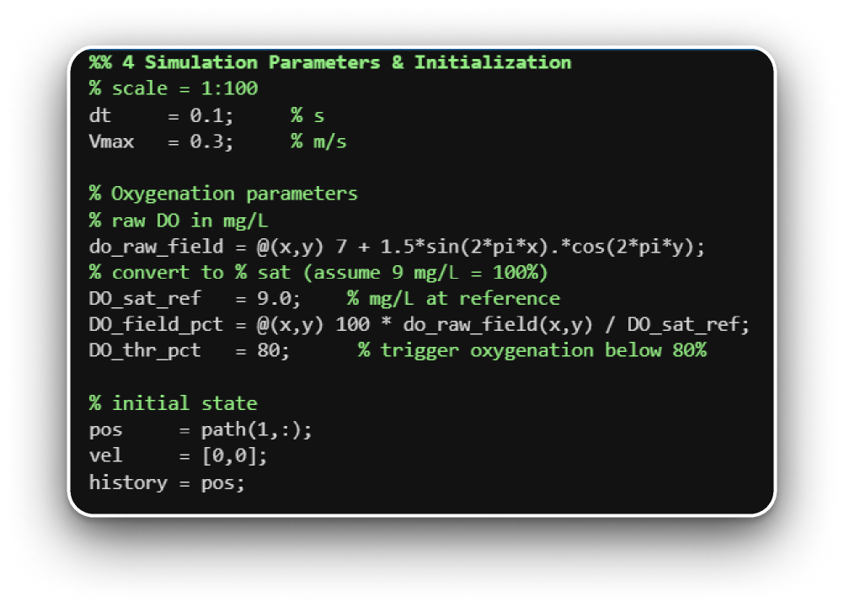
Route simulation
Parameters + O2 values
Shore + island avoidance

Slide 7
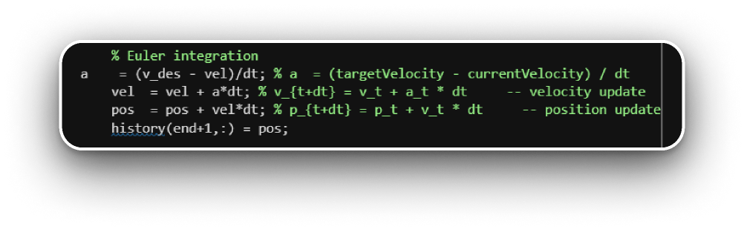
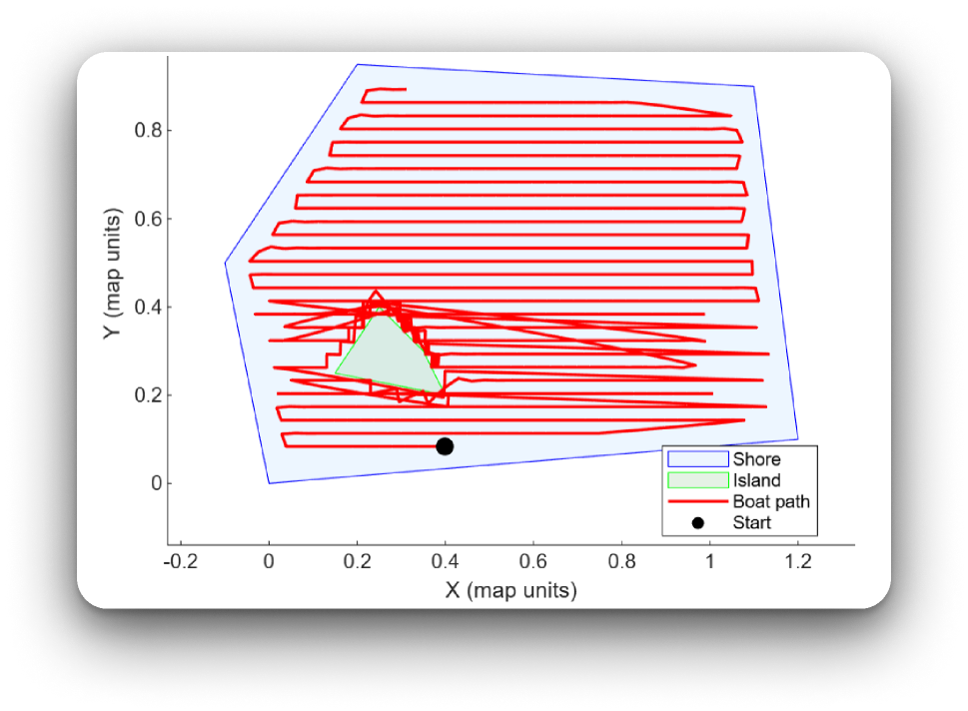

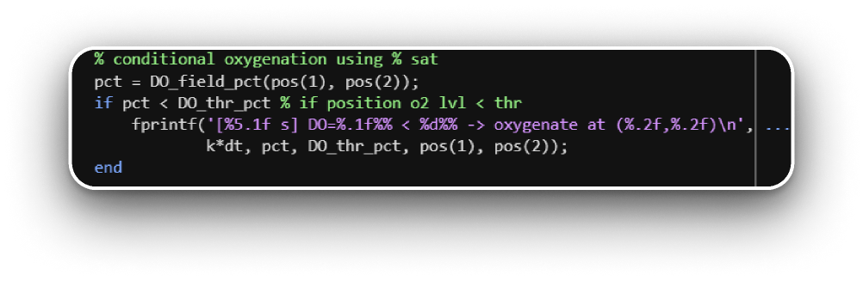
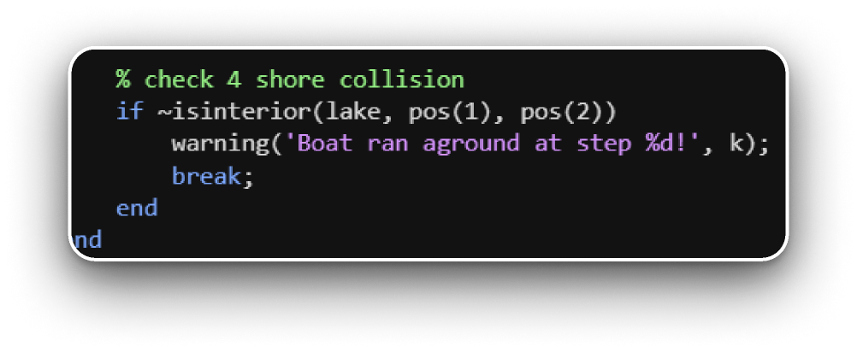

Euler integration
+
Oxygen level calculation via saturation
NEPTUNE-R’s route
shore collision checker

Slide 8

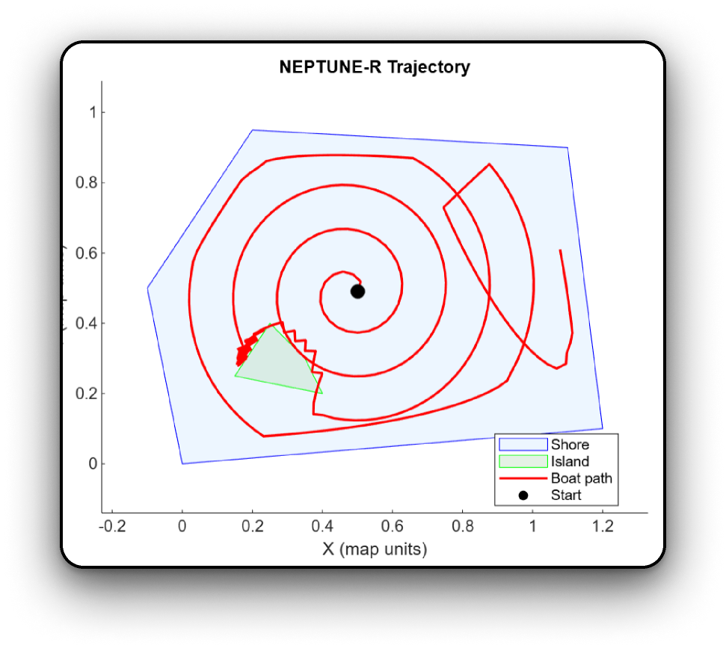
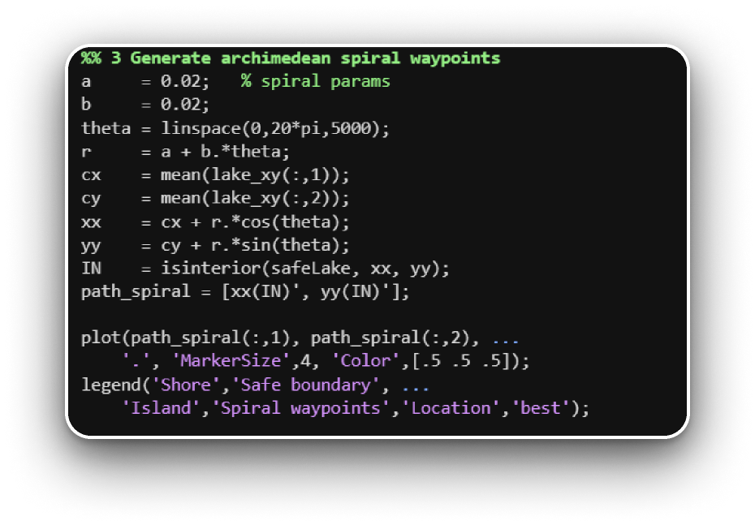

Archimedean spiral
Optimal for circular lakes

Slide 9


Overview of Real-time
Simulation

Slide 10

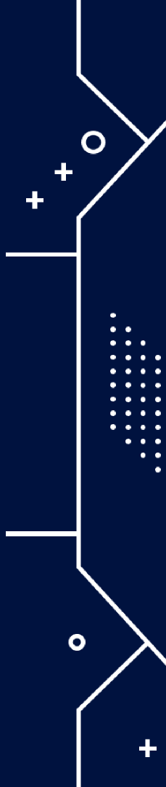
Thank you for your attention!
Project directed by IONELA MIHAELA CONSTANTIN​
By Mihnea Girbacica & Mitran Andrei [Group 1221EA]​
​

